Slide 1
COMP 520 - Compilers
Lecture 09 – Type Checking Theory and Contextual Analysis in PA3

Slide 2
Midterm 1 soon!
Make sure you finish PA2 on time.
Open notes, open lecture slides, open course website.
No other internet access.
Can use your IDE to read code, but cannot write any new code. Cannot run anything in IDE either.
Syntax highlighting is the main goal.
COMP 520: Compilers – S. Ali

Slide 3
Midterm 1 soon! (2)
The reason midterm 1 is so early in the semester is to gauge how you are doing.
By looking at your midterm 1 results, you can determine how the rest of the semester will go. PA3 is difficult, PA4 is even more so.
COMP 520: Compilers – S. Ali

Slide 4
More than one LL
this(.id)*(= Expr ;| [Expr] = Expr ; | ( ArgList? ) ; )
| boolean id = Expr ;
| id ( ( (.id)*( = Expr ; | [ Expr ] = Expr ; | ( ArgList? ) ; ) )
| [] id = Expr ; )
How problematic is this really? Especially given that Lexers need to be simple state machines.
COMP 520: Compilers – S. Ali

Slide 5
More than one LL(2)
id ( ( (.id)*( = Expr ; | [ Expr ] = Expr ; | ( ArgList? ) ; ) )
| [] id = Expr ; )
-=-=-=-=-=-=-=-=-
id ( .id(.id)*(=Expr;|[Expr]=Expr;|(ArgList?);)
| =Expr; | (ArgList?);
| [(] id = Expr;|Expr] = Expr; )
COMP 520: Compilers – S. Ali

Slide 6
More than one LL(3)
id ( .id(.id)*(=Expr;|[Expr]=Expr;|(ArgList?);)
| =Expr; | (ArgList?);
| [(] id = Expr;|Expr] = Expr; )
Drawback: A lot more symbols and repeated sequences. (Shown is only one of the 3 options in the first choice)
COMP 520: Compilers – S. Ali

Slide 7
More than one LL(3)
this(.id)*(= Expr ;| [Expr] = Expr ; | ( ArgList? ) ; )
| boolean id = Expr ;
| id ( .id(.id)*(=Expr;|[Expr]=Expr;|(ArgList?);)
| =Expr; | (ArgList?);
| [(] id = Expr;|Expr] = Expr; )
Drawback: A lot more symbols and repeated sequences.
COMP 520: Compilers – S. Ali

Slide 8
Parsing, Lexing, and []
Two ways to represent those rules as LL(1)
If going for the simpler one, then need to scan [] as a token by itself.
Question: how simple will the Lexer DFA be?
COMP 520: Compilers – S. Ali

Slide 9
$ε$-closure and $\hat{δ}$, Start with NFA
[
$$ε$$
Final States
S
$$ε$$
[
]
COMP 520: Compilers – S. Ali

Slide 10
$ε$-closure and $\hat{δ}$, Good enough for DFA?
[
$$ε$$
Final State
S
Any problems?
$$ε$$
[
]
COMP 520: Compilers – S. Ali

Slide 11
$ε$-closure and $\hat{δ}$- Cannot use NFA
[
$$ε$$
Non-deterministic, therefore not scannable.
(And whitespace issues)
S
$$ε$$
[
]
COMP 520: Compilers – S. Ali

Slide 12
$ε$-closure and $\hat{δ}$ (2)
\r, \t, \n, ‘ ‘
$$ε$$
]
[
ws
]
[
S
\n
/
/
not \n
$$ε$$
*
Not /
/
/*
*
*/
*
COMP 520: Compilers – S. Ali

Slide 13
$ε$-closure and $\hat{δ}$ (3)
\r, \t, \n, ‘ ‘
What happens if the input is: [ /8
$$ε$$
]
[
ws
]
[
S
\n
/
/
not \n
$$ε$$
*
Not /
/
/*
*
*/
*
COMP 520: Compilers – S. Ali

Slide 14
$ε$-closure and $\hat{δ}$ (4)
\r, \t, \n, ‘ ‘
$$ε$$
]
$ε$-closure method of NFA will “rewind” back to the latest known final state.
How practical is rewinding?
[
ws
]
[
\n
S
/
/
not \n
$$ε$$
*
Not /
/
/*
*
*/
*
COMP 520: Compilers – S. Ali

Slide 15
$ε$-closure and $\hat{δ}$ (5)
\r, \t, \n, ‘ ‘
$$ε$$
]
$ε$-closure method of NFA will “rewind” back to the latest known final state.
How practical is rewinding?
So long as it isn’t more than one Token, not a problem (keep the next token in your accumulated text).
[
ws
]
[
\n
S
/
/
not \n
$$ε$$
*
Not /
/
/*
*
*/
*
COMP 520: Compilers – S. Ali

Slide 16
Type Checking
COMP 520: Compilers – S. Ali

Slide 17
Type-Checking Table
For every type, should there be an entry where…
$$α×β→γ$$
E.g., int $×$ int $→$ int
Is this enough?
Will every int op int yield an int?
COMP 520: Compilers – S. Ali

Slide 18
Type-Checking Table (2)
For every type, should there be an entry where…
$$α×β→γ$$
E.g., int $×$ int $→$ int
What about 3 == 2? In that case, int $×$ int $→$ boolean
COMP 520: Compilers – S. Ali

Slide 19
Type-Checking Table (3)
Therefore, Type-Checking is a 3 input, 1 output table:
( $β$ $×$ $α$ $×$ op ) $→$ $γ$
E.g., int $×$ int $×$ {+,-,*,/} $→$ int
int $×$ int $×$ {==,!=,>,>=,<,<=} $→$ boolean
COMP 520: Compilers – S. Ali

Slide 20
Operator Overloading
Operator Overloading: give custom definitions to ops
Example, consider a “MyData” object that can accumulate integers and sorts them.
In C++, can create a method that defines:
MyData $×$ int $×$ {+} $→$ MyData
Where adding integers to MyData types will call that method.
COMP 520: Compilers – S. Ali

Slide 21
Bad Types
When an entry is missing, then the resultant type should be a specially designated type that is compatible with EVERY type.
This type, “ErrorType”, prevents type-checking errors from filling up your compiler’s error log.
COMP 520: Compilers – S. Ali

Slide 22
Bad Types (2)
This type, “ErrorType”, prevents type-checking errors from filling up your compiler’s error log.
Consider miniJava: (myObj + 3) + 5;
ClassType $×$ int $×$ {+} $→$ ErrorType (report error here)
ErrorType $×$ int $×$ {+} $→$ ErrorType (no need to report)
Second type check was valid.
COMP 520: Compilers – S. Ali

Slide 23
Bad Types (3)
Generalization:
( {ErrorType} $×$ AnyType $×$ AnyOp ) $→$ ErrorType
( AnyType $×$ {ErrorType} $×$ AnyOp ) $→$ ErrorType
( (TypeA,TypeB,Op) $∉$ TypeTable ) $→$ (Result=ErrorType)
( (TypeA,TypeB,Op) $∈$ TypeTable ) $→$ ( Result = GetEntry(TypeA,TypeB,Op) )
COMP 520: Compilers – S. Ali

Slide 24
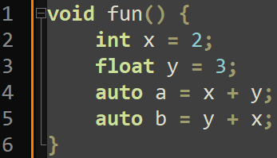
Does Order Matter?
Is A $×$ B the same as B $×$ A?
COMP 520: Compilers – S. Ali

Slide 25
Does Order Matter?
Is A $×$ B the same as B $×$ A?
Previous definitions state yes.
Your thoughts?
COMP 520: Compilers – S. Ali

Slide 26
Does Order Matter?
Is A $×$ B the same as B $×$ A?
Previous definitions state yes.
Not for miniJava, but yes for some languages.
Why?
COMP 520: Compilers – S. Ali

Slide 27
Order – Language Specifications
Language may specify that order can matter
C++ can specify order in the program itself:
COMP 520: Compilers – S. Ali

Slide 28
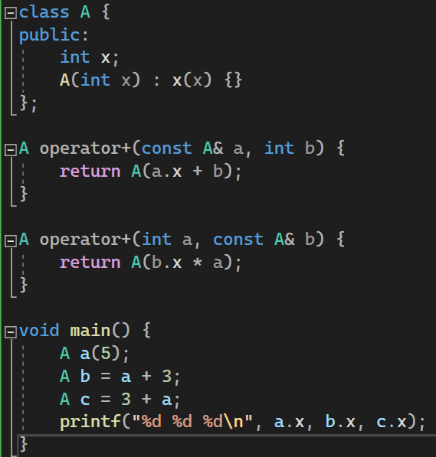
More Totally Sane Code
Why?
COMP 520: Compilers – S. Ali

Slide 29
More Totally Sane Code
Why?
You could make your compiler “keep” the first type if you wanted.
For example: 3 + 3.2 * 4.4;
Specify: int $×$ float … $→$ int
Specify: float $×$ int … $→$ float
COMP 520: Compilers – S. Ali

Slide 30
Type-Checking Table
Thus, how you construct your type checking table depends on the language.
COMP 520: Compilers – S. Ali

Slide 31
TypeCasting Tables
COMP 520: Compilers – S. Ali

Slide 32
TypeCasting / Type Conversions
Typecasting (or the conversion of a type) does not have an operator.
Formally:
$$α×β→α$$
Thus, the table for typecasting is: (TypeA,TypeB) $→$ TypeA, and some skip the $→$ entirely
E.g. ( (int)3.4f ) $→$ 3 (an int), which is (int,float)$→$int
COMP 520: Compilers – S. Ali

Slide 33
TypeCasting / Type Conversions (2)
$$α×β→α$$
The table for typecasting takes an input of (TypeA,TypeB), result is just TypeA.
If (x,y) $∉$ Table, then this is a type checking error.
The table usually has a result just to make the code easier to write up.
What is the exception?
COMP 520: Compilers – S. Ali

Slide 34
Automatic Conversions
boolean is just a 0 or 1, so we could:
int $×$ boolean $→$ int
boolean $×$ int $→$ boolean
This is also described as:
int $→$ {int, boolean}
(depends on how you construct the table)
COMP 520: Compilers – S. Ali

Slide 35
Automatic Conversions (2)
Java has more automatic conversions:
String $×$ Enum $→$ String
The Enum will automatically become a string that represents the text of that enum entry.
COMP 520: Compilers – S. Ali

Slide 36
Automatic Conversions (3)
Automatic conversions are AUTOMATIC
Note:
private int somefun( int a ) { … }
…
somefun( true );
… does not require explicitly typecasting (int)true
COMP 520: Compilers – S. Ali

Slide 37
Automatic Conversions (4)
Java has more automatic conversions:
String $×$ Enum $→$ String
Combine this with: String $×$ String $×$ {+} $→$ String (concatenation operation) and we can add enum to strings!
E.g.: myStr = myStr + someEnumVar;
COMP 520: Compilers – S. Ali

Slide 38
Automatic Type Casting Note
From the previous example, we can see that if there does not exist a type-check entry for:
$α×β×$ Op
… then we have to check all possible automatic typecasting for both $α$ and $β$.
If there exists conflicts, manual typecasting is enforced.
COMP 520: Compilers – S. Ali

Slide 39
Manual Typecasting
Consider the following:
(String,String,+)$→$String
(Integer,Integer,+)$→$Integer
TypeA a; TypeB b;
And both TypeA and TypeB can be typecasted with:
(String,TypeA), (String,TypeB), (Integer,TypeA), (Integer,TypeB)
What is the result type of a + b?
COMP 520: Compilers – S. Ali

Slide 40
Manual Typecasting
Consider the following:
(String,String,+)$→$String
(Integer,Integer,+)$→$Integer
TypeA a; TypeB b; both TypeA, TypeB $→$ {String,Integer}
What is the result type of a + b?
Answer: Your compiler must require a or b to be manually typecasted to either String or Integer. (String)a + b;
COMP 520: Compilers – S. Ali

Slide 41
Please note: miniJava
miniJava does not have typecasting nor automatic conversions.
miniJava does not allow boolean $×$ int $×$ Op
This lecture is meant to strengthen your compiler theory, please see next section for PA3 specifics.
COMP 520: Compilers – S. Ali

Slide 42
Programming Assignment 3
Identification and Type-Checking
COMP 520: Compilers – S. Ali

Slide 43
You own the ASTs for PA3 and forward
Can add, edit, remove any ASTs you want.
COMP 520: Compilers – S. Ali

Slide 44
Strategy
Two separate Visitor implementations
First identification, then type-checking
COMP 520: Compilers – S. Ali

Slide 45
Strategy (2)
Two separate Visitor implementations
First identification, then type-checking
It is possible to do this in one AST traversal. Optional, is a PA5 extra credit item.
COMP 520: Compilers – S. Ali

Slide 46
Identification Goal
Every Identifier gets a “decl” field added, of type Declaration
We want to locate where every identifier is declared.
Could be a VarDecl, ParameterDecl, MemberDecl, ClassDecl
COMP 520: Compilers – S. Ali

Slide 47
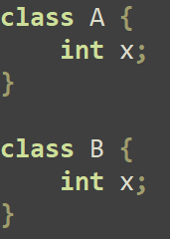
Identification Cache
Identifier “x” only makes sense in context.
Even if two identifiers’ underlying text is the same, the declaration can be different when appearing in different parts of the code.
Both use “x” as the identifier, but can only tell them apart in context.
COMP 520: Compilers – S. Ali

Slide 48
Identification Cache (2)
Identifier “x” only makes sense in context.
Even if two identifiers’ underlying text is the same, the declaration can be different when appearing in different parts of the code.
If we can resolve the Declaration, store it in that identifier’s decl field so we won’t have to traverse again.
COMP 520: Compilers – S. Ali

Slide 49
What is: IDTable
An object that internally stores a mapping from String to Declaration.
HashMap<String,Declaration> idTable;
COMP 520: Compilers – S. Ali

Slide 50
Scoped Identification (SI)
Implement a Stack<IDTable>
(Where IDTable is HashMap<String,Declaration>)
Level 0: ClassDecl
Level 1: MemberDecl (FieldDecl, MethodDecl)
Level 2+: LocalDecl (ParameterDecl, VarDecl)
COMP 520: Compilers – S. Ali

Slide 51
SI methods
openScope
closeScope
addDeclaration
findDeclaration
COMP 520: Compilers – S. Ali

Slide 52
openScope / closeScope
openScope: Push a new IDTable onto the stack
closeScope: Pop the top-most IDTable from the stack
Question: When should you open/close a scope?
COMP 520: Compilers – S. Ali

Slide 53
openScope / closeScope (2)
openScope: Push a new IDTable onto the stack
closeScope: Pop the top-most IDTable from the stack
When should you open/close a scope?
Entering/Leaving a method’s StatementList
Entering/Leaving a BlockStmt
COMP 520: Compilers – S. Ali

Slide 54
addDeclaration / findDeclaration
addDeclaration: Map a String (and optional context) to a Declaration. If this String exists on level 2+, then IDError should be thrown.
findDeclaration: With a String (and optional context), find a Declaration starting from the largest indexed scope and then working down.
COMP 520: Compilers – S. Ali

Slide 55
Identification Traversal – Method Body
In a method body, if you encounter a VarDeclStmt, visit the VarDecl and add that identifier to the top-most IDTable in your ScopedIdentification
If that identifier already exists at scope level 2+, then that is an identification error!
COMP 520: Compilers – S. Ali

Slide 56
Scoped Identification – Stack Visualization
ClassDecl “C”
0
IP
MemberDecl “x”
1
COMP 520: Compilers – S. Ali

Slide 57
Scoped Identification – Stack Visualization
ClassDecl “C”
0
IP
MemberDecl “x”
1
New IDTable
2
PUSH
COMP 520: Compilers – S. Ali

Slide 58
Scoped Identification – Stack Visualization
ClassDecl “C”
0
IP
MemberDecl “x”
1
VarDecl “x”
2
COMP 520: Compilers – S. Ali

Slide 59
Scoped Identification – Stack Visualization
ClassDecl “C”
0
MemberDecl “x”
IP
1
VarDecl “x”
2
COMP 520: Compilers – S. Ali

Slide 60
Scoped Identification – Stack Visualization
ClassDecl “C”
0
MemberDecl “x”
1
IP
VarDecl “x”
2
COMP 520: Compilers – S. Ali

Slide 61
Scoped Identification – Stack Visualization
ClassDecl “C”
0
MemberDecl “x”
1
IP
VarDecl “x”
2
2+
New IDTable
PUSH
3
COMP 520: Compilers – S. Ali

Slide 62
Scoped Identification – Stack Visualization
ClassDecl “C”
0
MemberDecl “x”
1
VarDecl “x”
IP
2
2+
VarDecl “y”
3
COMP 520: Compilers – S. Ali

Slide 63
Scoped Identification – Stack Visualization
ClassDecl “C”
0
MemberDecl “x”
1
VarDecl “x”
IP
2
2+
VarDecl “y”
3
COMP 520: Compilers – S. Ali

Slide 64
Scoped Identification – Stack Visualization
ClassDecl “C”
0
MemberDecl “x”
1
VarDecl “x”
2
IP
POP
VarDecl “y”
COMP 520: Compilers – S. Ali

Slide 65
More on Identification
Pre-defined names, out-of-order references
COMP 520: Compilers – S. Ali

Slide 66
Pre-defined Names
miniJava doesn’t have imports, so we need to provide some basic functionality.
You must MANUALLY add these entries into your IDTables for PA3, and we will use them in PA4.
Note, println takes an int, not a String.
COMP 520: Compilers – S. Ali

Slide 67
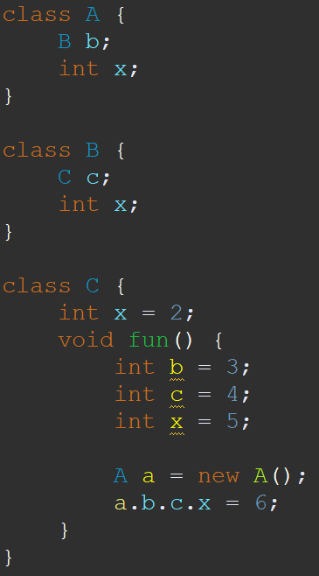
Out-of-order References
Note: class B is used as a type when B hasn’t yet been declared.
Question: How can we put the classes in our IDTables ahead of time?
COMP 520: Compilers – S. Ali

Slide 68
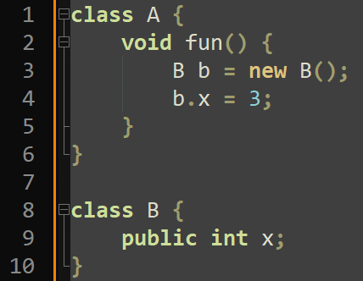
Out-of-order References (2)
Additionally, can refer to members of classes that have not yet been declared.
Question: How can we put the members in our IDTables ahead of time?
COMP 520: Compilers – S. Ali

Slide 69
Strategy: OOO References
Before you visit a method’s StatementList, add all ClassDecls in the Package AST to the level 0 IDTable.
Then, add all MemberDecl (FieldDecl/MethodDecl) to the IDTable as well.
Never drop below scope level 1.
COMP 520: Compilers – S. Ali

Slide 70
Strategy: OOO References (2)
Private members cannot be accessed externally.
Possible strategy: only add public members first, then when processing a class, add that class’s private members.
When leaving a class, make sure to remove those entries! (How would you handle this?)
Alternatively: check private later when resolving declarations. (this is probably easier than changing your level 1)
COMP 520: Compilers – S. Ali

Slide 71
Identification of QualRef
If one AST object has its own section, that means it should be the most fun part!
COMP 520: Compilers – S. Ali

Slide 72
Left-most Reference
Only the left-most reference should be resolved normally (start at the top of the SI stack, then work down).
Once you know the Declaration of the left-most reference, you have a context.
COMP 520: Compilers – S. Ali

Slide 73
Left-most Reference
QualRef(LHS,RHS): LHS is a Reference, and RHS is an Identifier.
With the type of the LHS (the context), resolve the RHS.
COMP 520: Compilers – S. Ali

Slide 74
Left-most Reference
QualRef(LHS,RHS): LHS is a Reference, and RHS is an Identifier.
With the type of the LHS (the context), resolve the RHS.
a.b means “.b” is resolved in the context of the type of “a”, which is class “A”.
COMP 520: Compilers – S. Ali

Slide 75
Left-most Reference
With the type of the LHS (the context), resolve the RHS.
Note: this means that you can bypass local variables.
“a.b.c.x” but “b”, “c”, “x” were all locally defined.
COMP 520: Compilers – S. Ali

Slide 76
A.b, where A is also a class name
Is it correct to say that if “A” is a class name, then “x” must be a static member?
COMP 520: Compilers – S. Ali

Slide 77
A.b, where A is also a class name (2)
COMP 520: Compilers – S. Ali

Slide 78
A.b, where A is also a class name
COMP 520: Compilers – S. Ali

Slide 79
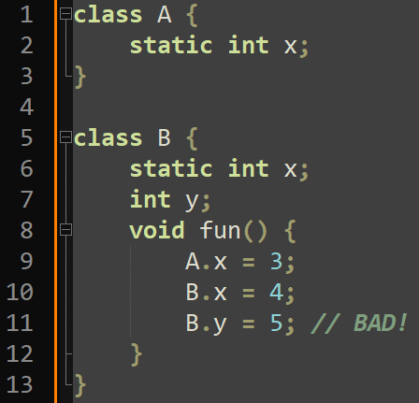
Static Reference
In miniJava, if the left-most reference is a class name AND is not declared at level 1+, then the RHS must be a static member.
E.g. “CLASSNAME.x”, where “x” must be a static member of “CLASSNAME”
COMP 520: Compilers – S. Ali

Slide 80
Static Context
If you are in a static method, then you can only access static members in your Class, and public static members in other classes.
Additionally, ThisRef is an identification error as “this” does not resolve to any declaration in a static method.
Question: where is ThisRef in memory?
COMP 520: Compilers – S. Ali

Slide 81
QualRef Strategy
Try to get the “context” by visiting the LHS reference.
With that context, resolve the RHS.
E.g. “a.b” will return the context of class “B”, thus allowing resolution of “a.b.c” where “c” is in the context of “B”
COMP 520: Compilers – S. Ali

Slide 82
No one strategy dominates all others
How you choose to identify “context” is up to you. It can be a String, ClassDecl, TypeDenoter, etc.
Even more important to plan PA3 than other assignments before starting to code.
If you change your Visitor’s parameter or return type, you may have to redo the entire class declaration!
COMP 520: Compilers – S. Ali

Slide 83
PA3 – Type Checking
COMP 520: Compilers – S. Ali

Slide 84
Type-Checking Table
In miniJava, type order does not matter, so A$×$B$×$op is the same as B$×$A$×$op
This means we can simplify our TypeChecking table.
COMP 520: Compilers – S. Ali

Slide 85
miniJava – Types must match
For miniJava, the types must match. There is no automatic type conversions nor manual typecasting.
COMP 520: Compilers – S. Ali

Slide 86
miniJava – Types must match
For miniJava, the types must match. There is no automatic type conversions nor manual typecasting.
Does this mean we can use a REALLY simple type-checking table where both types must match, and the result type is that type?
COMP 520: Compilers – S. Ali

Slide 87
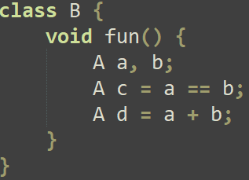
miniJava – Types must match
Does this mean we can use a REALLY simple type-checking table where both types must match, and the result type is that type?
Still need to formally clarify Type rules.
COMP 520: Compilers – S. Ali

Slide 88
Type-Checking Table (2)
Type Checking Rules
Operand Types | Operand | Result
boolean $×$ boolean | &&, || | boolean
int $×$ int | >, >=, <, <= | boolean
int $×$ int | +, -, *, / | int
$$α×α$$ | ==, != | boolean
int | (Unary) - | int
boolean | (Unary) ! | boolean
COMP 520: Compilers – S. Ali

Slide 89
ClassType
If two objects are both ClassType, are they comparable?
COMP 520: Compilers – S. Ali

Slide 90
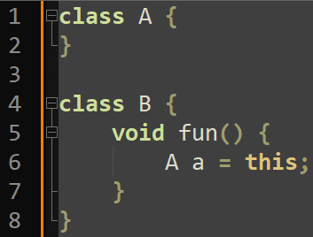
ClassType (No polymorphism in miniJava)
If two objects are both ClassType, are they comparable?
No, the underlying Identifier text must match.
Why is this enough?
COMP 520: Compilers – S. Ali

Slide 91
What type is ArrayType?
Recall: new int[4]
This expression is of ArrayType(IntType)
Thus, it can only be assigned to variables of type ArrayType(IntType)
IntType is shorthand for: BaseType( TypeKind.INT )
COMP 520: Compilers – S. Ali

Slide 92
What type is ArrayType? (2)
For array types:
First: Are both types ArrayType?
Second: Do the element types match? (Recursion)
Recursion needed to match ArrayType of ArrayType of ArrayType of ClassType.
COMP 520: Compilers – S. Ali

Slide 93
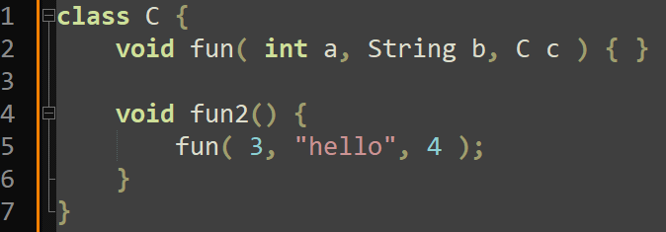
Type-Checking Methods
Scoped Identification only uses context and identifiers. Therefore, overloading methods by parameter types/counts is not allowed in miniJava.
COMP 520: Compilers – S. Ali

Slide 94
Type-Checking Methods (2)
As such, make sure there is an expression for every parameter, and that the types match.
COMP 520: Compilers – S. Ali

Slide 95
Type Errors
The ErrorType is compatible with ALL other types, and the result type is always another ErrorType and this does not cause an error to be reported.
If a type is not allowed in an operation with another type, then the result type is an ErrorType.
COMP 520: Compilers – S. Ali

Slide 96
Unsupported Type
The UNSUPPORTED type is not compatible with any type (including itself) and causes an error to be reported. The result type will be ErrorType.
Make sure String’s type is UNSUPPORTED, otherwise String can be initialized with new String(), which is not implemented in miniJava.
COMP 520: Compilers – S. Ali

Slide 97
Unsupported Type (2)
The String predefined class is an UNSUPPORTED type.
String is not supported in miniJava, but available to be implemented as a part of PA5.
We need String to be able to declare the main method.
COMP 520: Compilers – S. Ali

Slide 98
Unsupported Type (3)
UNSUPPORTED$×$ErrorType
Question: should an error be reported?
COMP 520: Compilers – S. Ali

Slide 99
Unsupported Type (4)
UNSUPPORTED$×$ErrorType does not need to be reported (only way ErrorType exists is if an error was reported earlier anyway).
But it can be reported if you want to report an extra error where String is utilized.
COMP 520: Compilers – S. Ali

Slide 100
Type-Checking Strategy
Implement a TypeChecking Visitor that uses a TypeDenoter return type.
Visiting a node synthesizes a TypeDenoter for that type.
Create a method, input is the two TypeDenoters, (or one for Unary), and output is the resultant TypeDenoter.
Or create a table, but that would have a lot of null entries.
COMP 520: Compilers – S. Ali

Slide 101
Type-Checking Strategy (2)
Ensure index expressions are integers
Ensure condition expressions in if/while are boolean
Ensure operands are compatible, and return the appropriate type when visiting that BinExpr/UnaryExpr
COMP 520: Compilers – S. Ali

Slide 102
Other Contextual Constraints
COMP 520: Compilers – S. Ali

Slide 103
Contextual Analysis
There are contextual parts of Java (and miniJava) that do not quite fit Identification or Type Checking.
We can easily implement these as a part of either.
COMP 520: Compilers – S. Ali

Slide 104
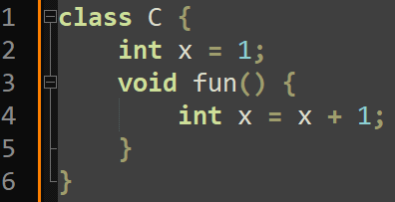
Contextual Analysis (2)
If an identifier is being declared, then it cannot be used in the expression.
Even if the expression can be evaluated first!
Not allowed!
COMP 520: Compilers – S. Ali

Slide 105
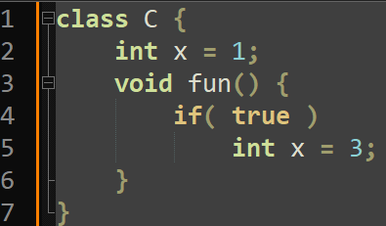
Contextual Analysis (3)
You cannot have a variable declaration only in a scope to itself.
A BlockStmt (new scope) is necessary for VarDeclStmt.
Not allowed!
COMP 520: Compilers – S. Ali

Slide 106
Enjoy your weekend!
PA3 released, but not due for over a month.
PA2 due in less than a week!
WA2 due Monday night!!!
Midterm on Thursday 2024-02-22
COMP 520: Compilers – S. Ali

Slide 107
End

Slide 108
COMP 520: Compilers – S. Ali

Slide 109
COMP 520: Compilers – S. Ali

Slide 110
COMP 520: Compilers – S. Ali

Slide 111
COMP 520: Compilers – S. Ali

